Slide 1
Learning Discriminative Projections for Text Similarity Measures
Scott Wen-tau Yih
Joint work with Kristina Toutanova, John Platt, Chris Meek
Microsoft Research

Slide 2

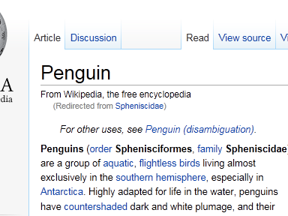
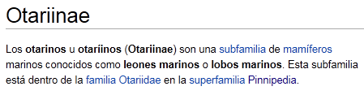
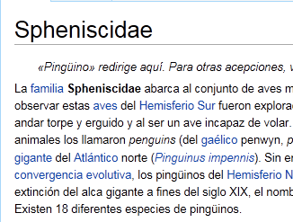
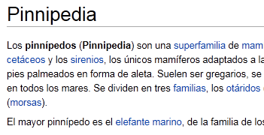
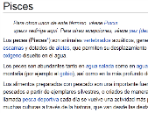
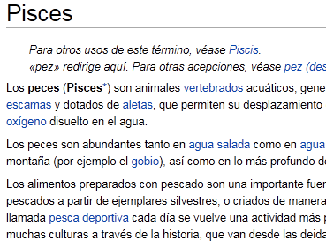
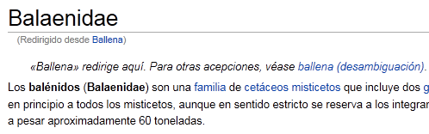
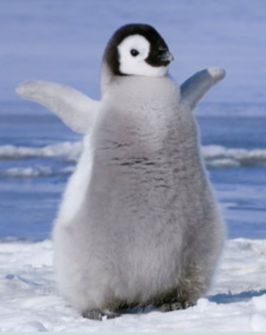
Cross-language Document Retrieval
Spanish Document Set
English Query Doc

Slide 3

Web Search & Advertising

Slide 4
Web Search & Advertising
Query: ACL in Portland
ACL Construction LLC (Portland)
ACL Construction LLC in Portland, OR -- Map, Phone Number, Reviews, … www.superpages.com
ACL HLT 2011
The 49th Annual Meeting of the Association for Computational Linguistics…
acl2011.org

Slide 5
Web Search & Advertising
Query: ACL in Portland
Don't Have ACL Surgery
Used By Top Athletes Worldwide Don't Let Them Cut You See Us First www.arpwaveclinic.com
Expert Knee Surgeons
Get the best knee doctor for your torn ACL surgery.
EverettBoneAndJoint.com/Knee
ACL: Anterior Cruciate Ligament injuries

Slide 6

Vector Space Model
v_{q}
cos($θ$)
θ
v_{d}
Represent text objects as vectors
Word/Phrase: term co-occurrences
Document: term vectors with TFIDF/BM25 weighting
Similarity is determined using functions like cosine of the corresponding vectors
Weaknesses
Different but related terms cannot be matched
e.g., (buy, used, car) vs. (purchase, pre-owned, vehicle)
Not suitable for cross-lingual settings

Slide 7
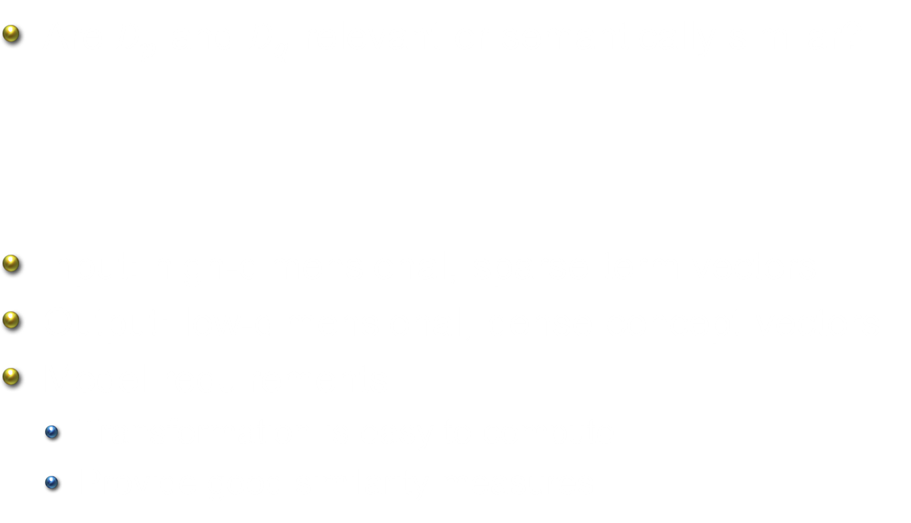



Learning Concept Vector Representation
Are $D_{p}$ and $D_{q}$ relevant or semantically similar?
Input: high-dimensional, sparse term vectors
Output: low-dimensional, dense concept vectors
Model requirements
Transformation is easy to compute
Provide good similarity measures
$$sim(D_{p}, D_{q})$$
$$D_{p}$$
$$D_{q}$$

Slide 8
Ideal Mapping
High-dimensional space
Low-dimensional space

Slide 9
Dimensionality Reduction Methods
Supervised
CPLSA
S2Net
OPCA
PLTM
HDLR
JPLSA
CCA
CL-LSI
Unsupervised
PLSA
PCA
LDA
LSA
Probabilistic
Projection

Slide 10
Outline
Introduction
Problem & Approach
Experiments
Cross-language document retrieval
Ad relevance measures
Web search ranking
Discussion & Conclusions

Slide 11

Goal – Learn Vector Representation
Approach: Siamese neural network architecture
Train the model using labeled (query, doc)
Optimize for pre-selected similarity function (cosine)
$$y$$
v_{qry}
v_{doc}
Query
Doc

Slide 12
Goal – Learn Vector Representation
Approach: Siamese neural network architecture
Train the model using labeled (query, doc)
Optimize for pre-selected similarity function (cosine)
$$y$$
v_{qry}
v_{doc}
Model
Query
Doc

Slide 13







S2Net – Similarity via Siamese NN
Model form is the same as LSA/PCA
Learning the projection matrix discriminatively
v_{qry}
v_{doc}
$$c_{1}$$
$$c_{k}$$
$$V_{qry}=A^{T}F_{qry}$$
$$A_{d×k}$$
$$t_{1}$$
$$t_{d}$$

Slide 14








Pairwise Loss – Motivation
In principle, we can use a simple loss function like mean-squared error: ${\frac{1}{2}\left(y−f_{sim}\left(v_{qry},v_{doc}\right)\right)}^{2}$. But…
$$Doc_{1}$$ | $$−$$
$$0.95$$
$$0.89$$
$$0.54$$
$$0.43$$
$$0.21$$
$$Doc_{2}$$ | $$+$$
$$Query$$
$$Doc_{3}$$ | $$−$$
$$Doc_{4}$$ | $$+$$
$$Doc_{5}$$ | $$−$$

Slide 15
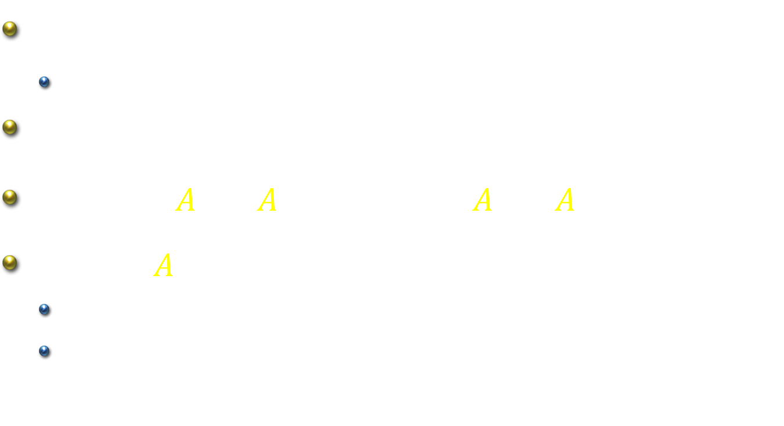
Pairwise Loss
Consider a query $q$ and two documents $d_{1}$ and $d_{2}$
Assume $d_{1}$is more related to $q$, compared to $d_{2}$
$F_{q}, F_{d_{1}}, F_{d_{2}}$: original term vectors of $q,d_{1}$and $d_{2}$
$Δ=f_{sim}\left(A^{T}F_{q}, A^{T}F_{d_{1}}\right)−f_{sim}\left(A^{T}F_{q}, A^{T}F_{d_{2}}\right)$
$Loss\left(Δ;A\right)=\log{(1+\exp\left(−γΔ\right))}$
$γ$: scaling factor, as $Δ∈\left[−2,2\right]$
$γ=10$ in the experiments

Slide 16
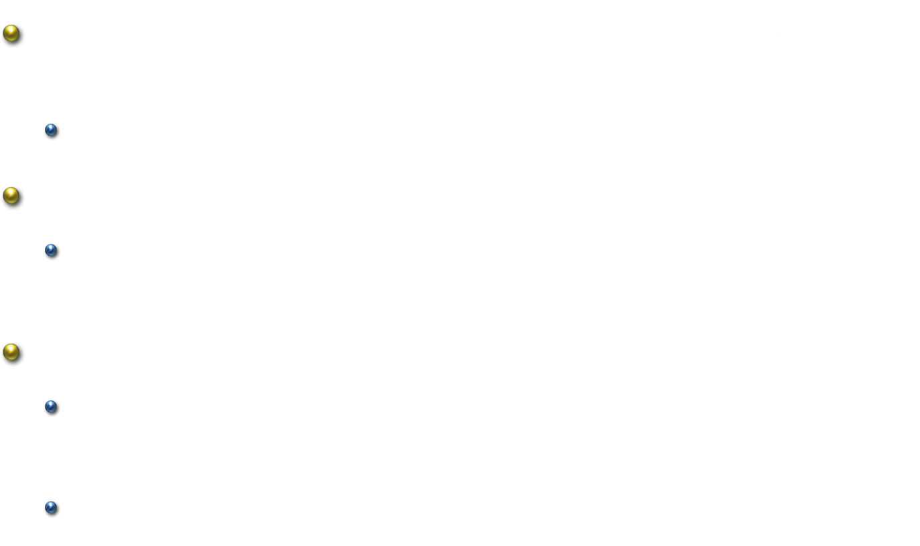
Model Training
Minimizing the loss function can be done using standard gradient-based methods
Derive batch gradient and apply L-BFGS
Non-convex loss
Starting from a good initial matrix helps reduce training time and converge to a better local minimum
Regularization
Model parameters can be regularized by adding a smoothing term $\frac{β}{2}{\left\|A−A_{0}\right\|}^{2}$ in the loss function
Early stopping can be effective in practice

Slide 17
Outline
Introduction
Problem & Approach
Experiments
Cross-language document retrieval
Ad relevance measures
Web search ranking
Discussion & Conclusions

Slide 18
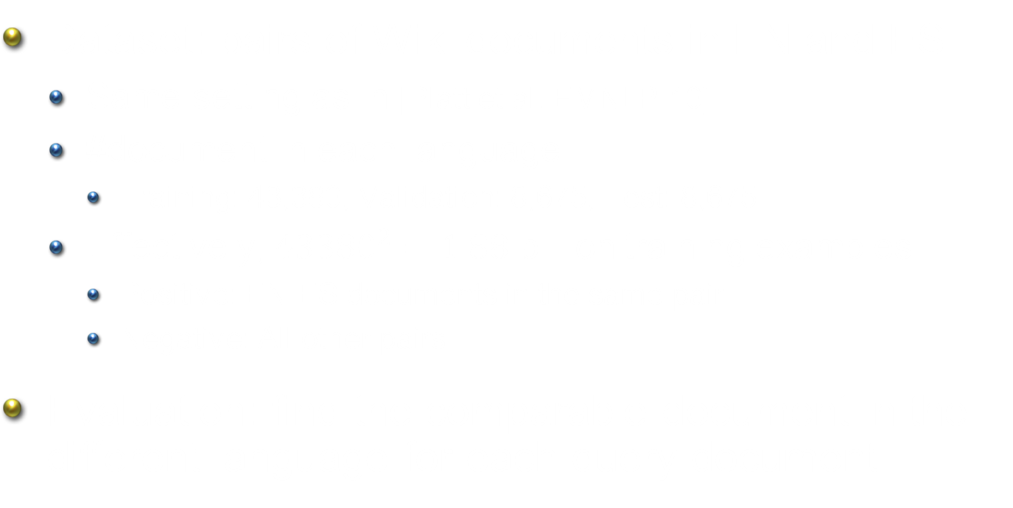
Cross-language Document Retrieval
Dataset: pairs of Wiki documents in EN and ES
Same setting as in [Platt et al. EMNLP-10]
#document in each language
Training: 43,380, Validation: 8,675, Test: 8,675
Effectively, ${43380}^{2}=1.88$ billion training examples
Positive: EN-ES documents in the same pair
Negative: All other pairs
Evaluation: find the comparable document in the different language for each query document

Slide 19
Results on Wikipedia Documents

Slide 20
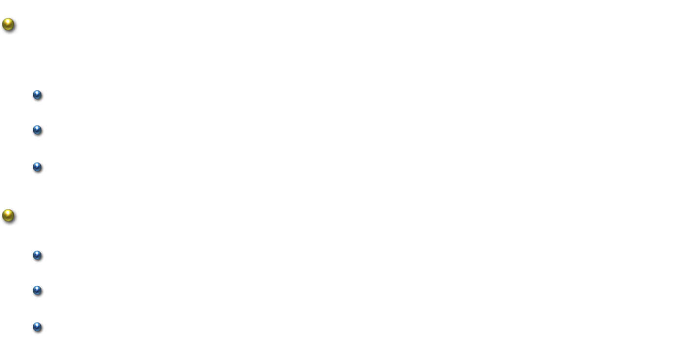
Ad Relevance Measures
Task: Decide whether a paid-search ad is relevant to the query
Filter irrelevant ads to ensure positive search experience
$F_{qry}$: pseudo-document from Web relevance feedback
$F_{doc}$: ad landing page
Data: query-ad human relevance judgment
Training: 226k pairs
Validation: 169k pairs
Testing: 169k pairs

Slide 21
Better
14.2% increase!

Slide 22


Web Search Ranking [Gao et al., SIGIR-11]
Train latent semantic models
Evaluate using labeled data
Parallel corpus from clicks
82,834,648 query-doc pairs
Human relevance judgment
16,510 queries
15 doc per query in average
query 1
query 2
query 3
$$⋯$$
doc 1
doc 2
doc 3
$$⋯$$
query
doc 1 | Good
doc 2 | Fair
doc 3 | Bad

Slide 23
Results on Web Search Ranking
0.479
0.460
Only S2Net outperforms VSM compared to other projection models

Slide 24
Results on Web Search Ranking
0.479
0.460
After combined with VSM, results are all improved
More details and interesting results of generative topic models can be found in [SIGIR-11]

Slide 25
Outline
Introduction
Problem & Approach
Experiments
Cross-language document retrieval
Ad relevance measures
Web search ranking
Discussion & Conclusions

Slide 26
Model Comparisons
S2Net vs. generative topic models
Can handle explicit negative examples
No special constraints on input vectors
S2Net vs. linear projection methods
Loss function designed to closely match the true objective
Computationally more expensive
S2Net vs. metric learning
Target high-dimensional input space
Scale well as the number of examples increases

Slide 27
Why Does S2Net Outperform Other Methods?
Loss function
Closer to the true evaluation objective
Slight nonlinearity
Cosine instead of inner-product
Leverage a large amount of training data
Easily parallelizable: distributed gradient computation

Slide 28
Conclusions
S2Net: Discriminative learning framework for dimensionality reduction
Learns a good projection matrix that leads to robust text similarity measures
Strong empirical results on different tasks
Future work
Model improvement
Handle Web-scale parallel corpus more efficiently
Convex loss function
Explore more applications
e.g., word/phrase similarity

